Slide 1

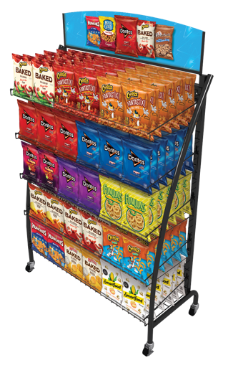
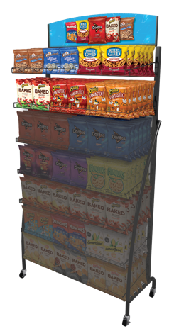
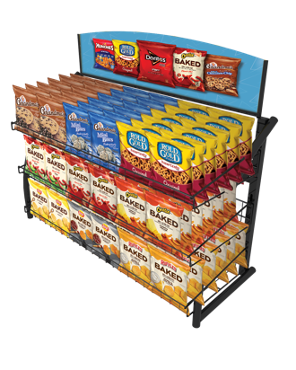








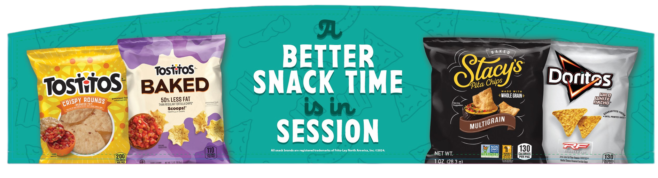

MERCHANDISING SOLUTIONS
TURBO SWEEP FLOOR
TURBO SWEEP 2 SHELF
RISER ADD-0N
TURBO SWEEP COUNTERTOP
Dimensions
Quantity
Dimensions
Quantity
38” W x 16” D x 58” H
0
36” W x 14” D x 17” H
0
26” W x 16” D x 58” H
0
24” W x 14” D x 17” H
0
Dimensions
Quantity
20” W x 16” D x 58” H
0
Capacity: 294 SVL
EQI #40033
38” W x 15” D x 24” H
0
Capacity: 210 SVL
EQI #40028
26” W x 15” D x 24” H
0
20” W x 15” D x 24” H
0
Capacity: 126 SVL
EQI #40032
TURBO SWEEP HEADER OPTIONS
Headers
18”
24”
36”
Core Portfolio (Single-Sided)
Snacks/Intense (Double-Sided)
Clean Label (Single-Sided)
Quantity
A. Core Portfolio
0
0
0
0
B. Snacks/Intense
0
0
0
0
C. Clean Label
0
0
0
0
For more details, visit PepsiCoSchoolSource.com, scan the QR code, or contact your local sales rep.
PepsiCo sales rep:
Name:
Type Name Here
Email:
Type Email Address Here
All trademarks are owned by PepsiCo, Inc. and its afiliates © 2023

Slide 2
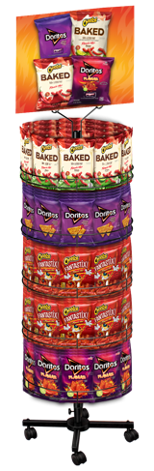

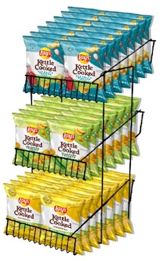
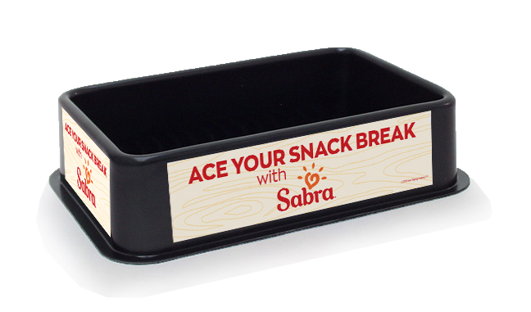


MERCHANDISING SOLUTIONS
KD SPINNER FLOOR RACK
QUAKER® GRANOLA
BAR RACK
Dimensions
Quantity
Dimensions
Quantity
To top of header
20” W x 20” D x 54” H
0
19.04” W x 9” D x 30.45” H
To top of header
Capacity: 125 SVL
EQI #7702
19.04” W x 9” D x 20.23” H
0
Plastic Tray
Qty
3- TIER GRAVITY FEED
COUNTERTOP RACK
8.02” L x 4.1” W x 2.36” D
Plastic Tray Inside
Header Options
W x 3.12”
Wire Shelves
Qty
10.98” W x 9.65” D x 3.43” T
SABRA® COUNTERTOP
ICE BIN K-12
0
0
Capacity: 36 Bags / 96 Bars
EQI K24X87A23
Qty
A. Doritos
B. FL Snack
Qty
Dimensions
Quantity
0
0
11” W x 14” D x 20” H
0
Capacity: 48 SVL
EQI #4007102
Dimensions
Quantity
C. LKC
D. Intense
11.77” W x 10.4” D x 29.69” H
0
Dimensions
Quantity
Capacity: 36 Bags / 20 Bars
EQI FSV587MP23A
18.5” W x 12.25” D x 4.5” H
0
Capacity: 30 Sabra® Single Serve
EQI PSA42250
Displays are and remain the property of PepsiCo and are loaned to customers at no charge (except where prohibited), and must be exclusively stocked with PepsiCo product.
For more details, visit PepsiCoSchoolSource.com, scan the QR code, or contact your local sales rep.
PepsiCo sales rep:
Name:
Type Name Here
Email:
Type Email Address Here
All trademarks are owned by PepsiCo, Inc. and its afiliates © 2023

