Slide 1
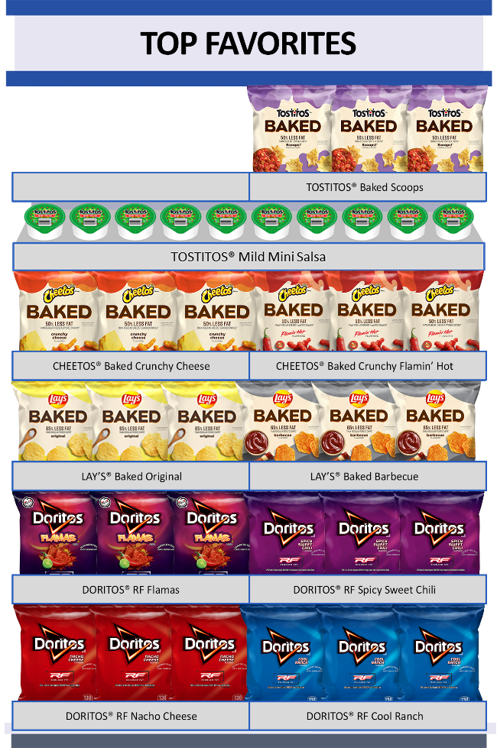
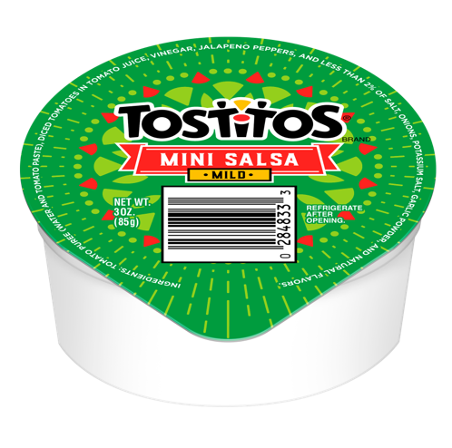
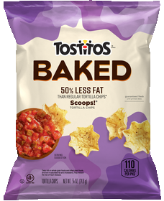
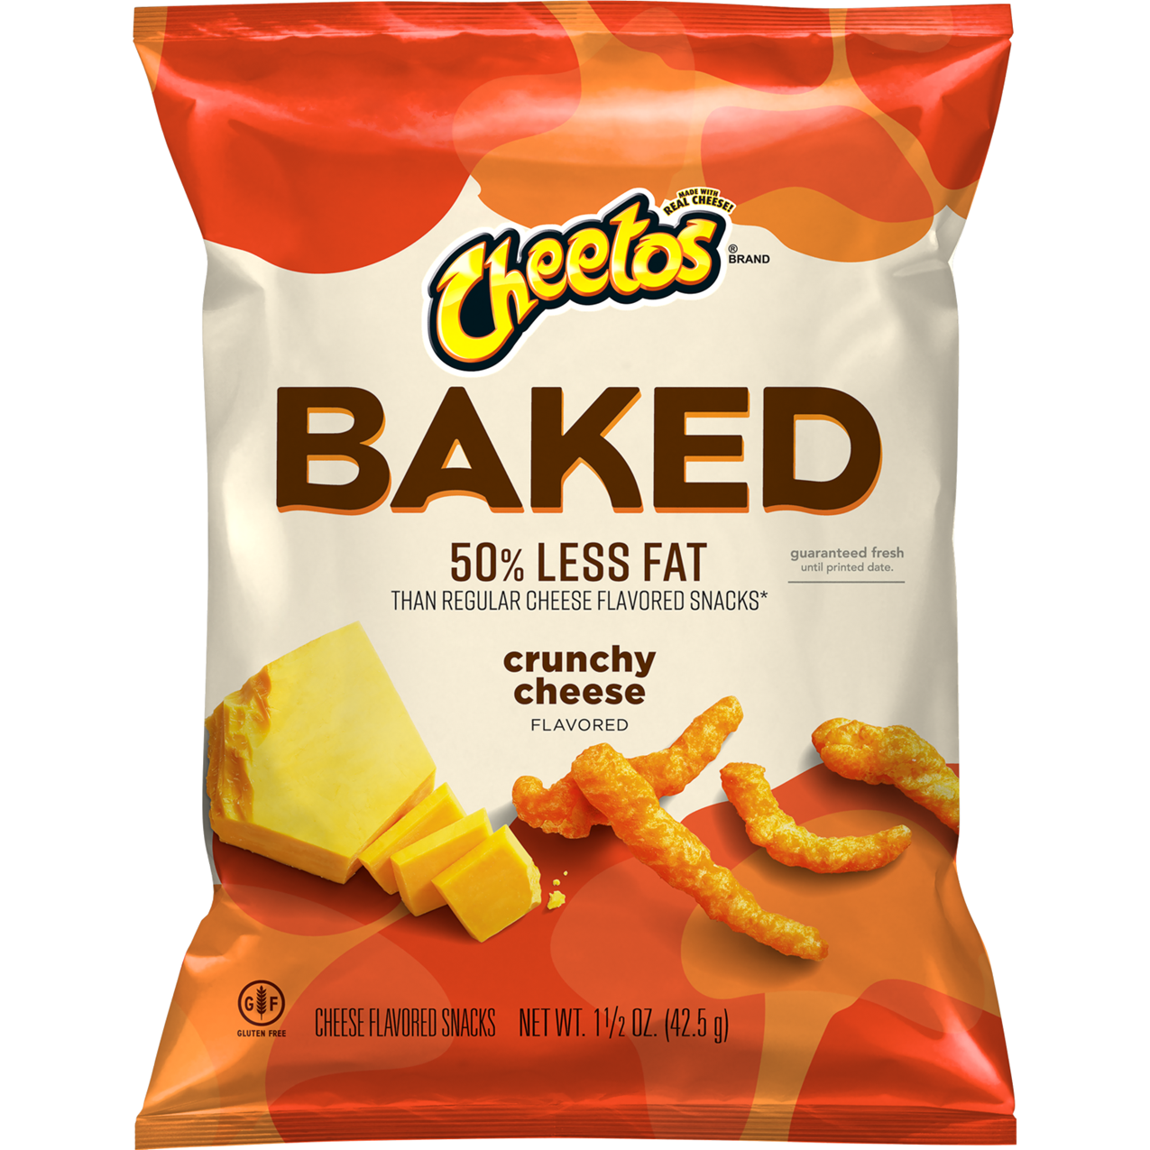
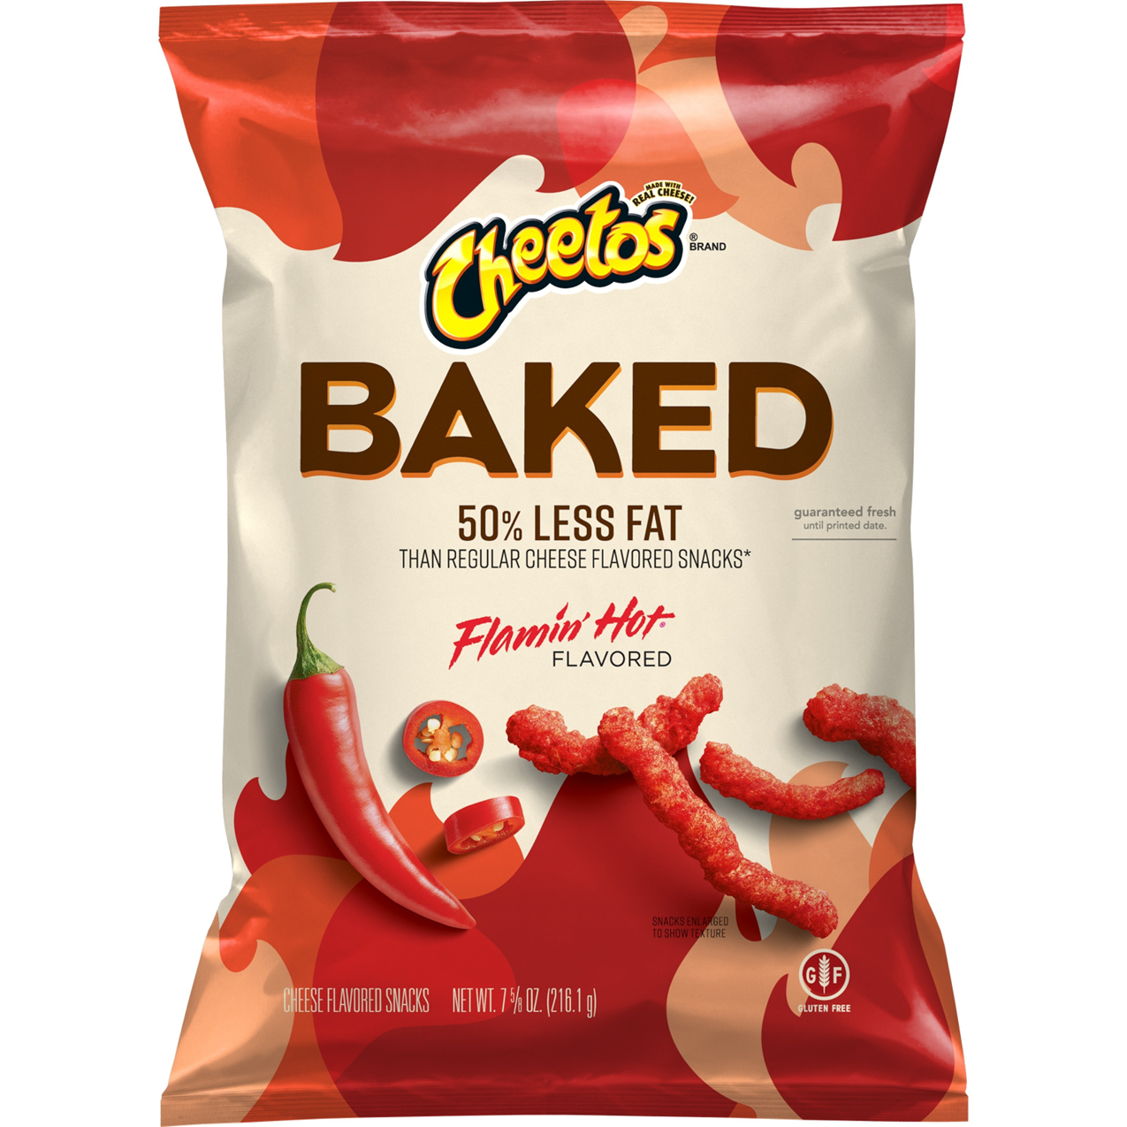
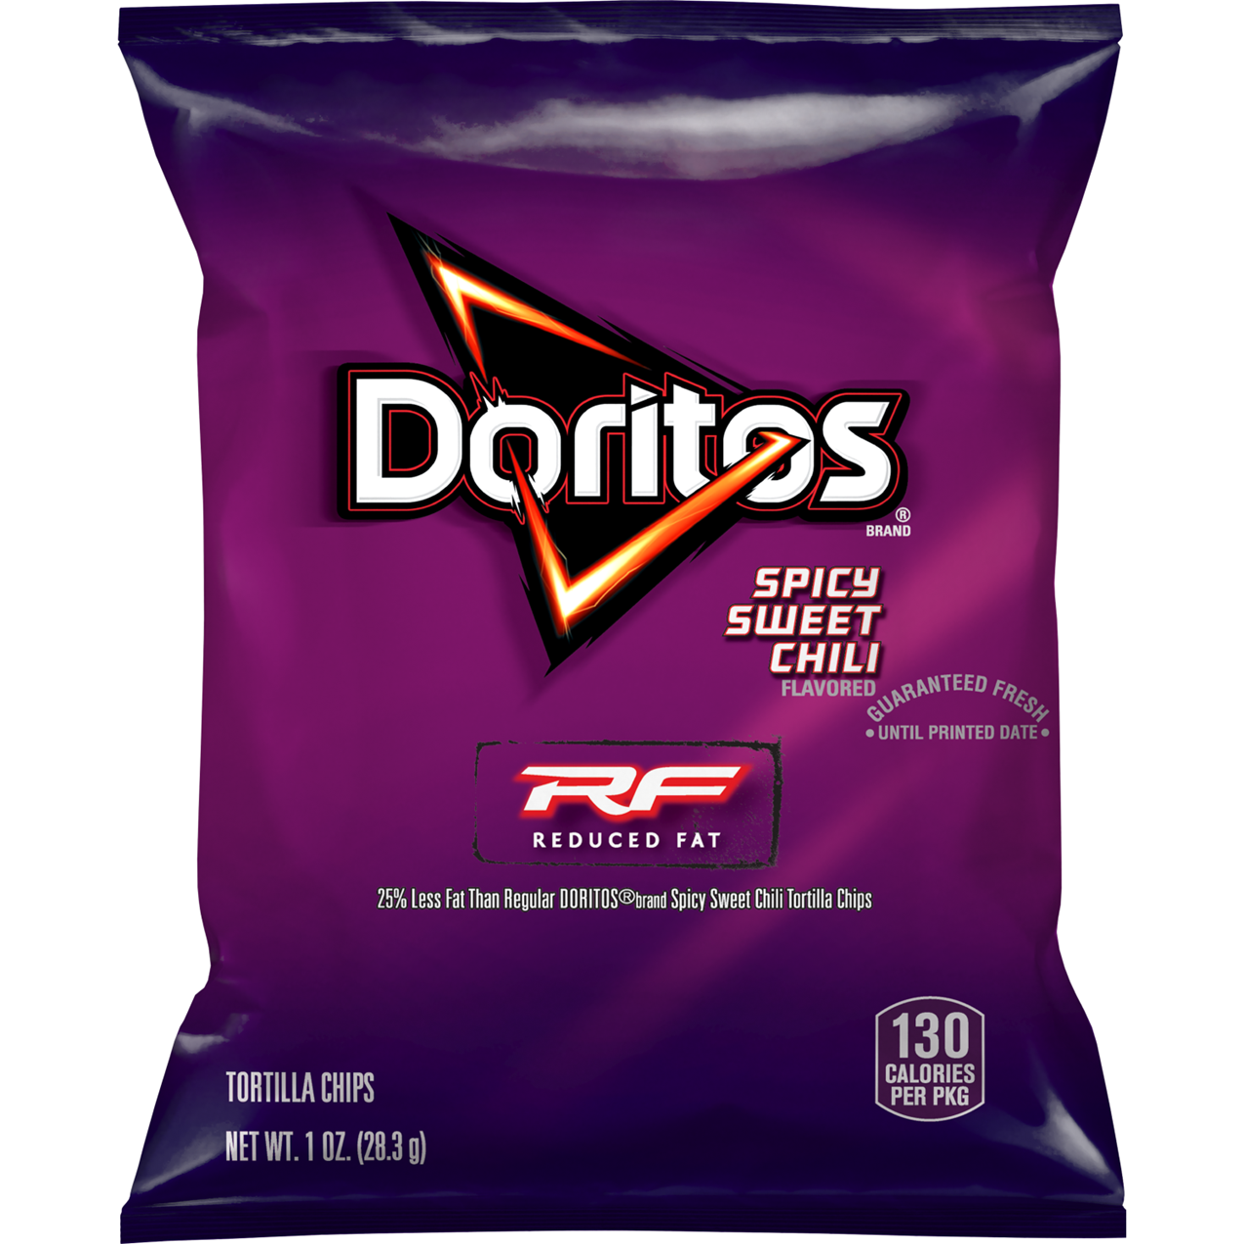
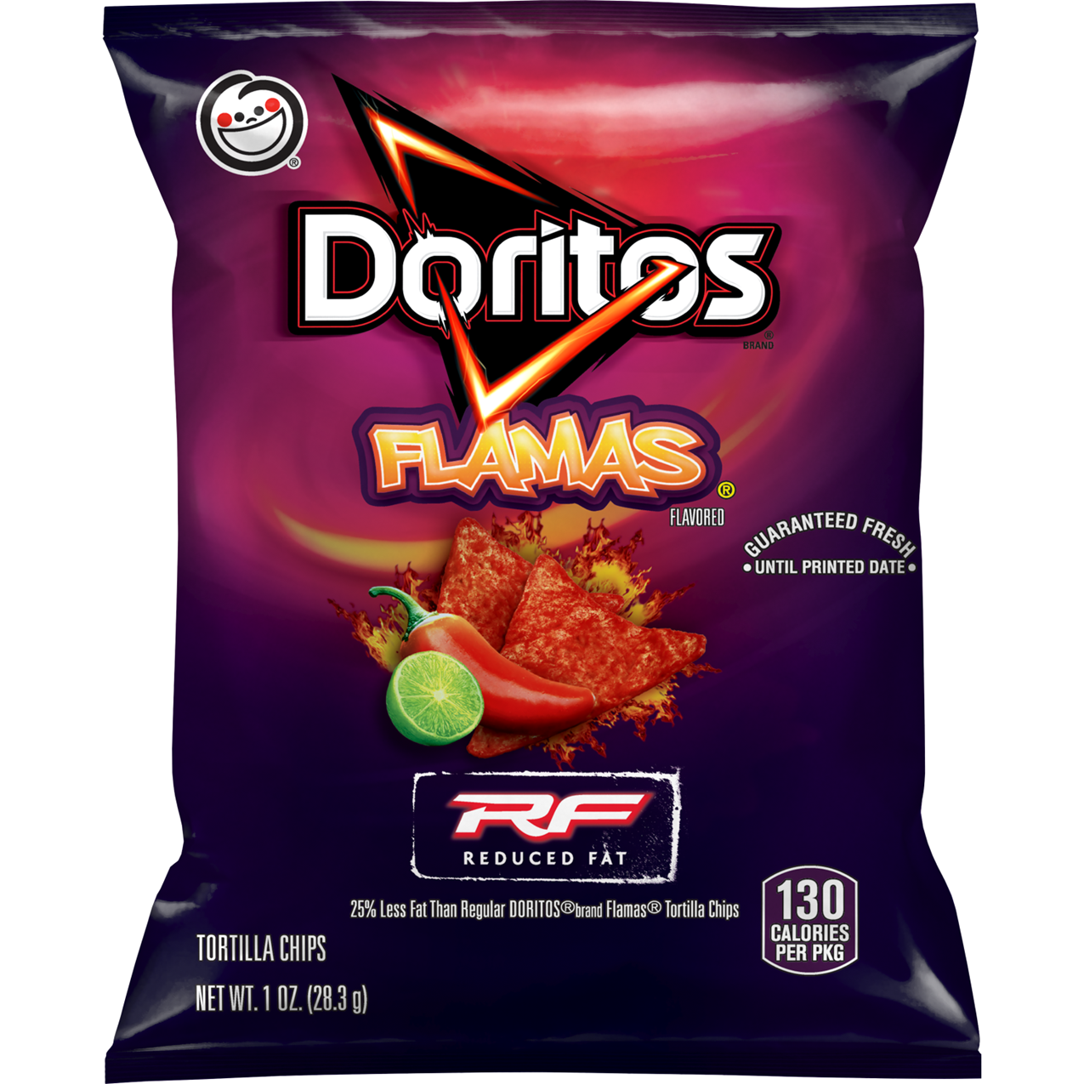
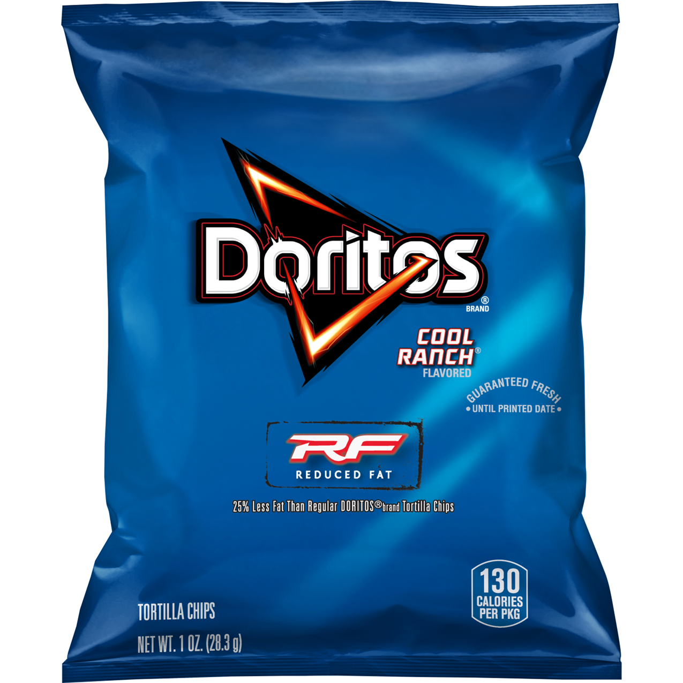
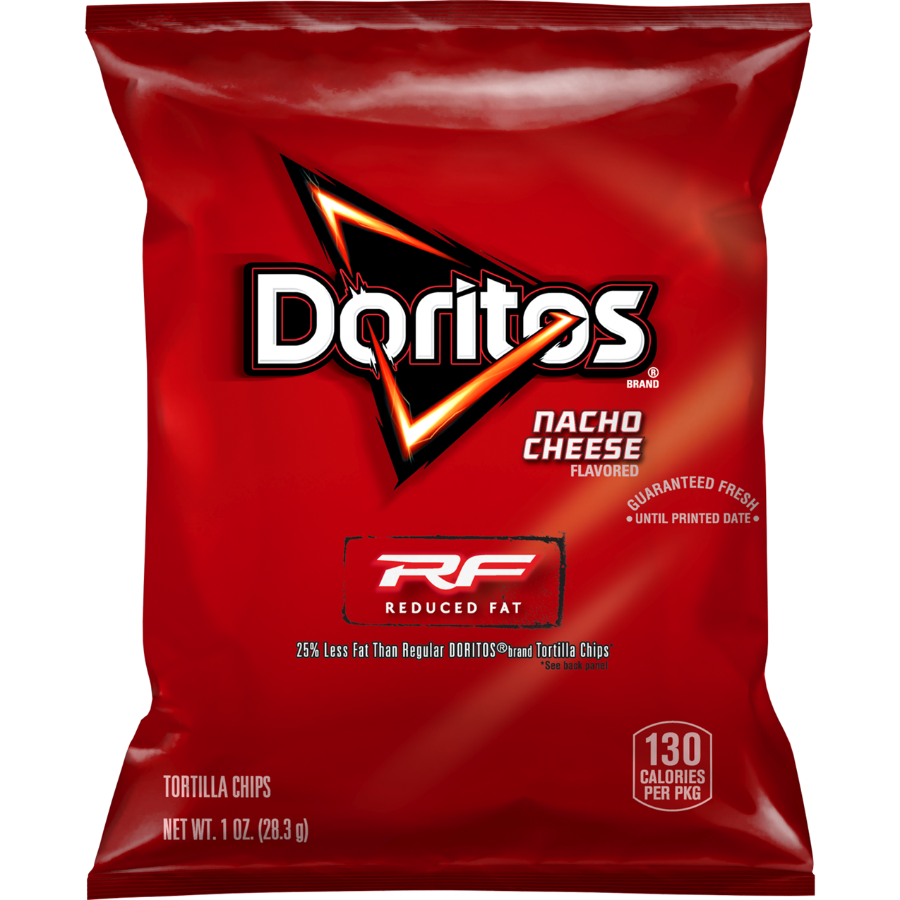
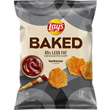
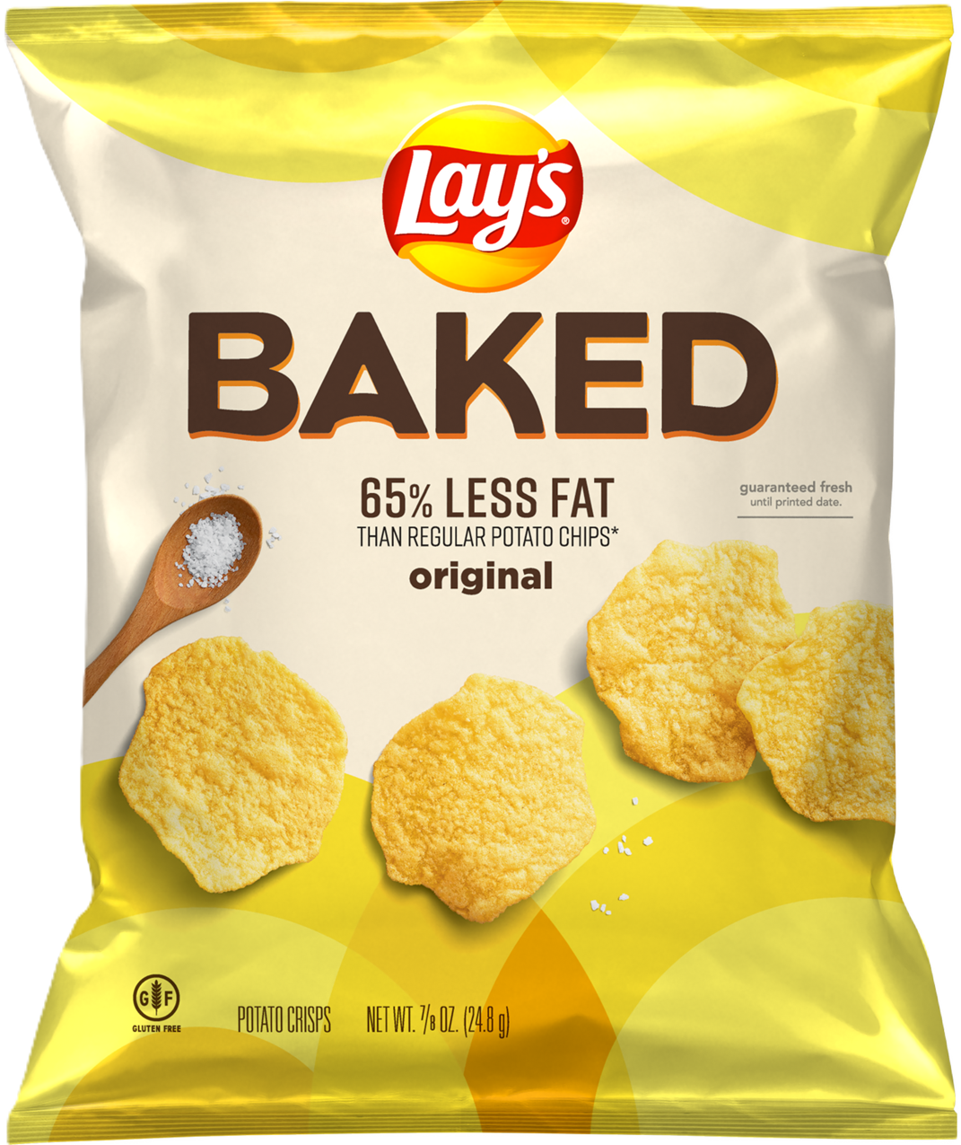
Planogram Support
Innovation or Region Choice!
Check out our 2024 innovation or visit www.PepsiCoSchoolSource.com to select other regional favorites
For custom planograms contact your PepsiCo Sales Representative or visit our website to reach out for support
Product Name | Oz Wt | Case Pack | Meal Component (per serving) | Case GTIN | Distributor Code
ON THE TRAY OR A LA CARTE
Tostitos® Mild Mini Salsa | 3.0oz. | 168 | ½ cup VEG | 00028400748513 | (editable field)
Baked Tostitos® Scoops Whole Grain Rich Tortilla Chips | 0.875oz. | 72 | 1.25 OEG | 00028400425377 | (editable field)
Baked Cheetos® Reduced Fat Whole Grain Rich Flamin’ Hot Snacks | 0.875oz. | 104 | 1.25 OEG | 00028400629843 | (editable field)
Baked Cheetos® Reduced Fat Whole Grain Rich Cheddar Cheese Snacks | 0.875oz. | 104 | 1.25 OEG | 00028400629331 | (editable field)
Doritos® Reduced Fat Spicy Sweet Chili Flavored Tortilla Chips | 1oz. | 72 | 1.5 OEG | 00028400490931 | (editable field)
Doritos® Reduced Fat Flamas Flavored Tortilla Chips | 1oz. | 72 | 1.5 OEG | 00028400628297 | (editable field)
Doritos® Reduced Fat Cool Ranch Flavored Tortilla Chips | 1oz. | 72 | 1.5 OEG | 00028400360968 | (editable field)
Doritos® Reduced Fat Nacho Cheese Flavored Tortilla Chips | 1oz. | 72 | 1.5 OEG | 00028400317481 | (editable field)
A LA CARTE ONLY
Baked Lay’s® BBQ | 0.875oz. | 60 |  | 00028400320788 | (editable field)
Baked Lay’s® Original | 0.875oz. | 60 |  | 00028400336253 | (editable field)

Slide 2
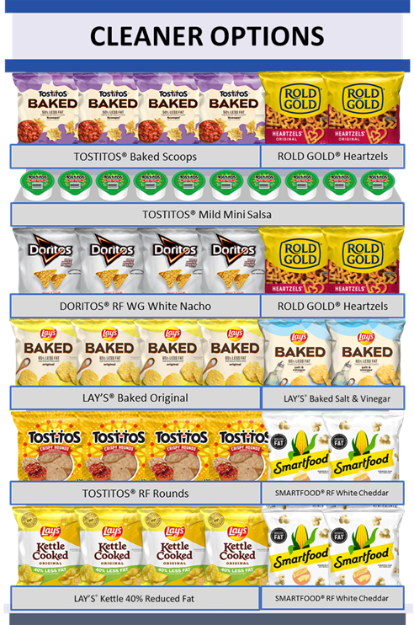
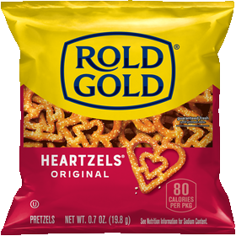
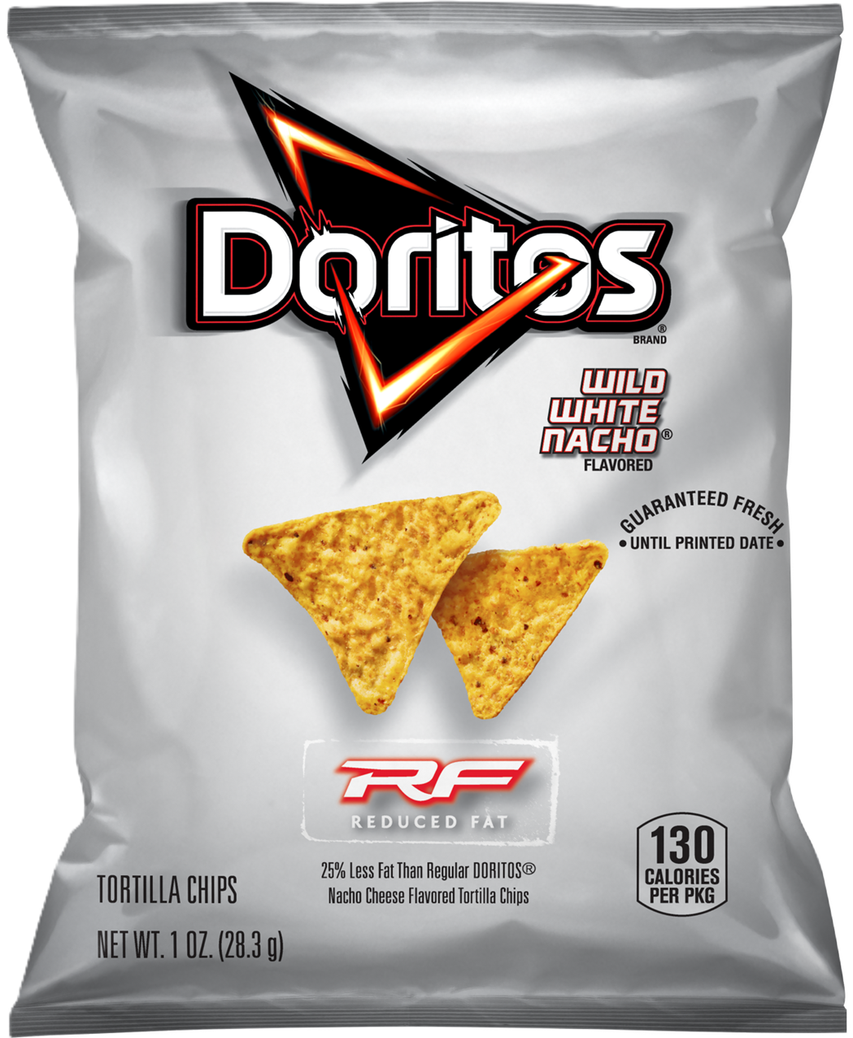
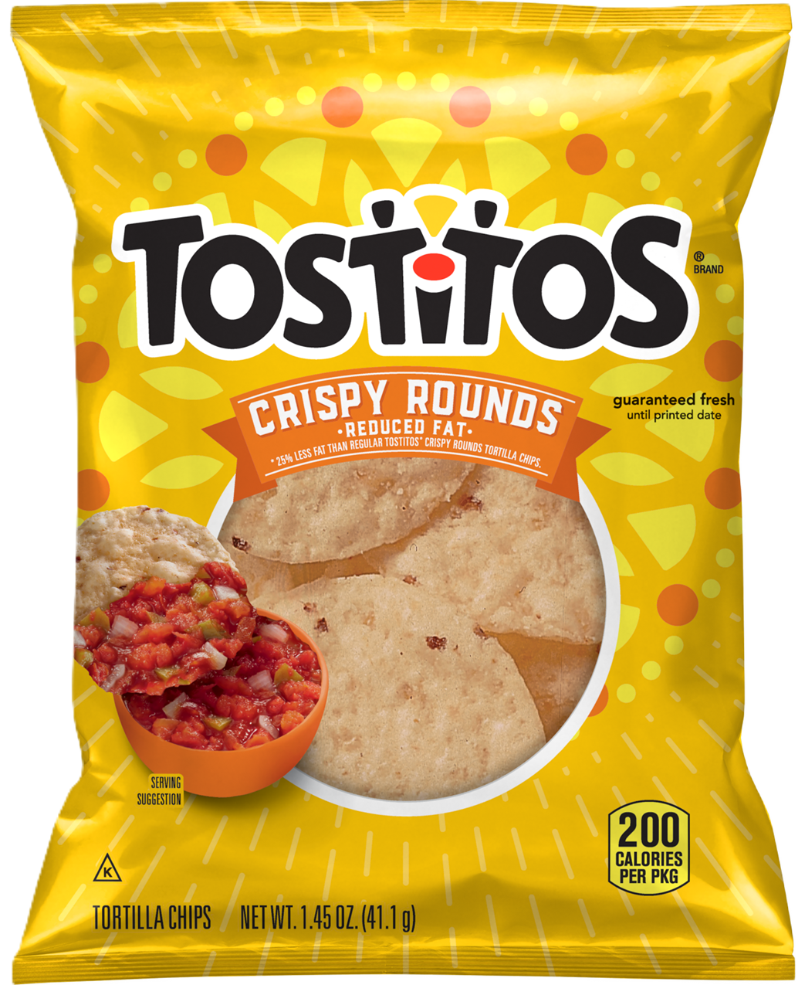
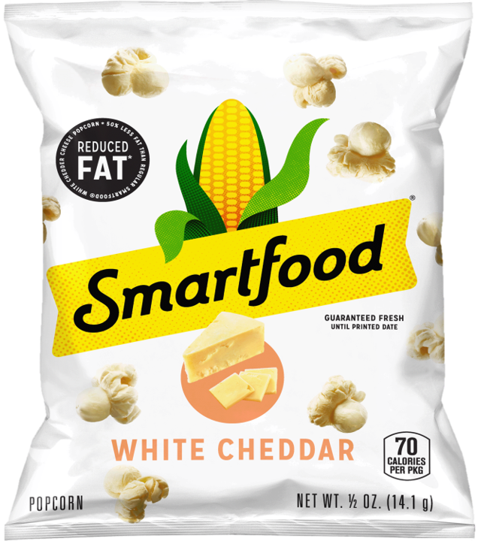
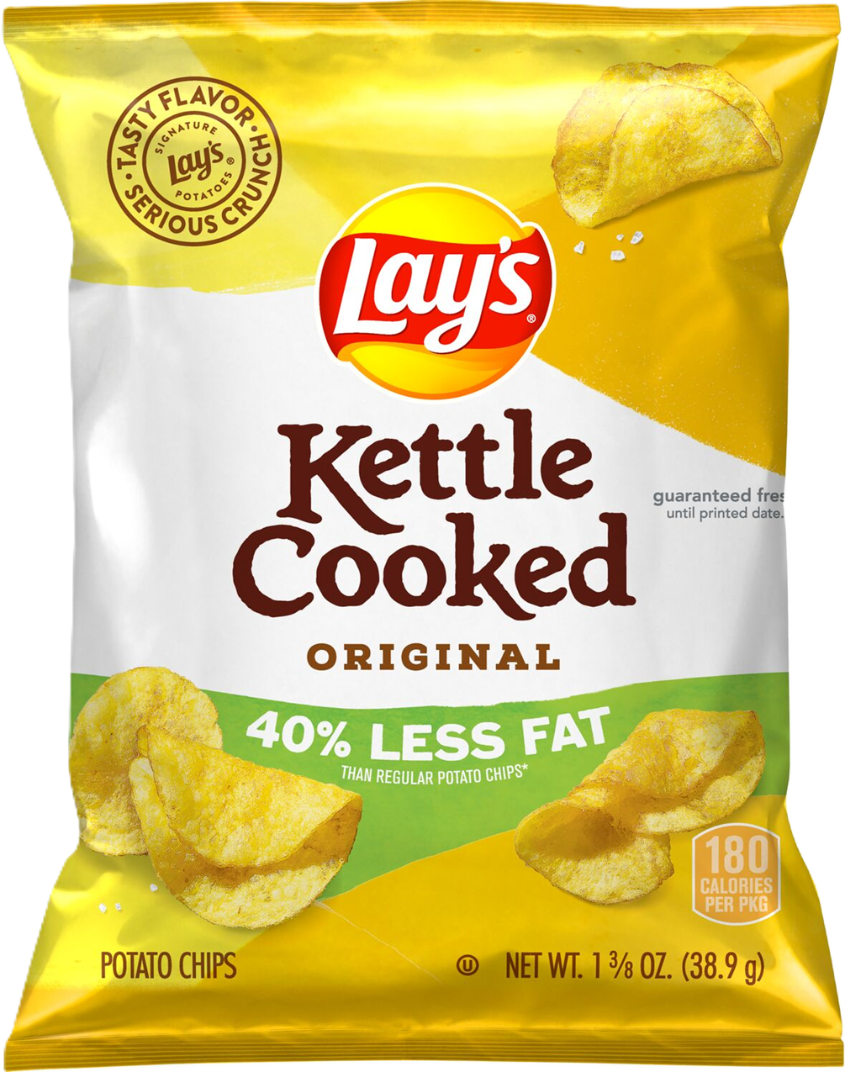
Planogram Guardrails
Merchandise no fewer than 2 facings per SKU
Group “like” items (potato chips, tortilla chips, etc.) and brands together in blocks
Place best-selling SKUs at eye-level and featured innovation at the top or within a brand block
Product Name | Oz Wt | Case Pack | Meal Component (per serving) | Case GTIN | Distributor Code
ON THE TRAY OR A LA CARTE
Tostitos® Mild Mini Salsa | 3.0oz. | 168 | ½ cup VEG | 00028400748513 | (editable field)
Baked Tostitos® Scoops Whole Grain Rich Tortilla Chips | 0.875oz. | 72 | 1.25 OEG | 00028400425377 | (editable field)
Rold Gold® Heartzels | 0.7oz. | 104 | 1 OEG | 00028400159401 | (editable field)
Doritos® Reduced Fat Wild White Nacho Flavored Tortilla Chips | 1oz. | 72 | 1.5 OEG | 00028400676090 | (editable field)
Tostitos® Reduced Fat Crispy Rounds Tortilla Chips | 2oz. | 64 | 2 OEG | 00028400443807 | (editable field)
Smartfood® Reduced Fat White Cheddar Popcorn | 0.5oz. | 72 | 0.25 OEG | 00028400111300 | (editable field)
A LA CARTE ONLY
Lay’s® Kettle 40% Reduced Fat Original | 1.375oz. | 64 |  | 00028400251150 | (editable field)
Baked Lay’s® Salt & Vinegar | 0.875oz. | 60 |  | 00028400748476 | (editable field)
Baked Lay’s® BBQ | 0.875oz. | 60 |  | 00028400320788 | (editable field)
Baked Lay’s® Original | 0.875oz. | 60 |  | 00028400336253 | (editable field)

