Slide 1
Drive Profit with A La Carte
Adding A La Carte to your food & beverage program is a profitable way to serve additional students through the day
Students are seeking products from their favorite brands at school and our K-12 portfolio helps bring the excitement of those brands into products that meet USDA guidelines
Filling one shelf of your Frito Lay rack daily is equivalent to an incremental $5,000 in annual sales!
Schools who participate in A La Carte programs save by:
Reinvesting A La Carte sales into an enhanced menu program to drive meal participation
Using profits to staff open roles
Looking to launch an A La Carte program at your school or district? Contact your PepsiCo Sales Representative or reach out to us a www.PepsiCoSchoolSource.com to get started

Slide 2
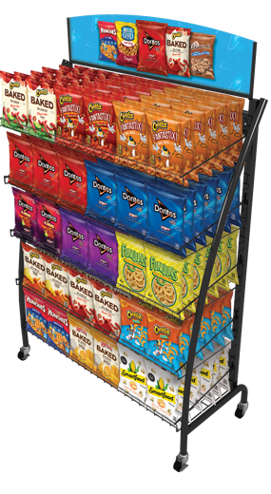
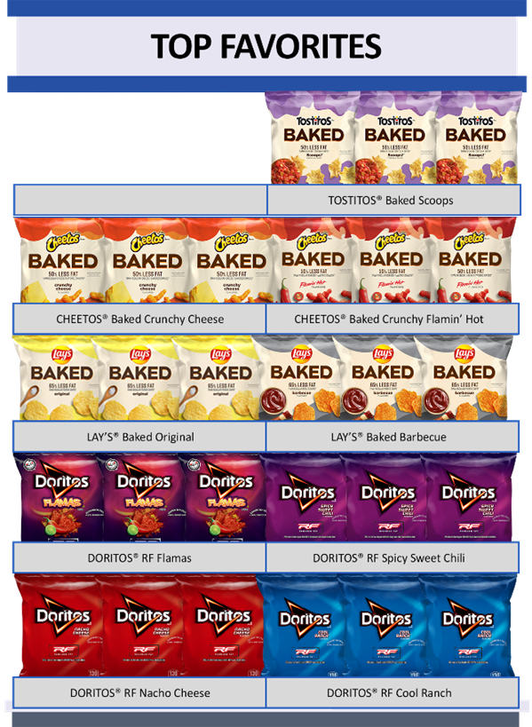
We offer merchandising solutions and planograms designed to optimize your A La Carte sales
Increase A La Carte sales by following planograms
Over 60% of snack purchases are not planned
An organized and consistent display makes it easy for students to find their favorite snacks
Planogram Guardrails
Innovation or Region Choice!
Merchandise no fewer than 2 facings per SKU
Group “like” items (potato chips, tortilla chips, etc.) and brands together in blocks
Place best-selling SKUs at eye-level and featured innovation at the top or within a brand block

